Slide 1



EMPLOYEE ATTRITION ANALYSIS
Presentation by Ojas Chaudhary

Slide 2

INTRODUCTION
Employee attrition is a critical challenge for organizations, impacting productivity, team morale, and operational costs. Our project focuses on analyzing employee data to understand the underlying reasons behind a company' s high attrition rate. Through comprehensive HR analytics, we aim to uncover key factors contributing to employee attrition. Our data-driven approach will enable the company to make informed decisions to reduce the attrition rate, thereby enhancing productivity and reducing financial losses.

Slide 3

BUSINESS PROBLEM STATEMENT
A Company, established a few years ago, is grappling with a persistent 15% annual employee attrition rate. This high turnover is significantly impacting productivity, team morale, and operational costs. Analysis shows that replacing an employee cost approximately 1.5 to 2 times their annual salary and much more in lost productivity, translating to substantial financial losses for the company. To address this issue, we propose conducting a HR analytics study. This data-driven approach will enable the company to make informed decisions, potentially reducing the attrition rate to below 10% within the next fiscal year and saving financial losses for the company.

Slide 4
KEY PERFORMANCE INDICATORS (KPIs)
Attrition Rate: 16.2%
Key Performance Indicators (KPIs) are critical metrics that help in evaluating the effectiveness and overall health of the organization. They provide insights into various aspects of the workforce, such as attrition, retention, salary, performance, and employee satisfaction.
Department-wise, Research & Development has the highest attrition rate at 63.71%, followed by Sales at 28.27%, and Human Resources at 8.02%.
The average distance from home to the office is 9.19 miles.
The average employee experience is 11.28 years.
Work environment, job satisfaction, and work-life balance have average ratings of 2.73, 2.73, and 2.76 respectively.
Employee Avg Age: 37
Average Salary: $65.1K
Avg Years At Company: 7

Slide 5

ANALYSIS & INSIGHTS
To facilitate a comprehensive understanding of the various factors contributing to employee attrition, we have grouped them into several key categories.
These groupings are essential because no single factor can solely account for attrition. By categorizing similar factors, we can gain comprehensive insights into the reasons for attrition and identify areas that require attention.

Slide 6








Employee Portfolio
Work Culture
Includes performance rating, total experience, years at the company, and number of companies worked.
Includes environment satisfaction, job satisfaction, work-life balance, and job involvement.
Career Progression
FACTORS ANALYZED
Job Related Factors
Includes job level, years since last promotion, and training times last year.
Includes department, job role, and years with current manager.
Salary and Financial Incentives
Commute & Traveling
Includes salary, salary hike, and stock option level.
Demographics
Includes business travel and distance from home.
Includes age, gender, and marital status.

Slide 7

SOME IMPORTANT FACTORS

Slide 8
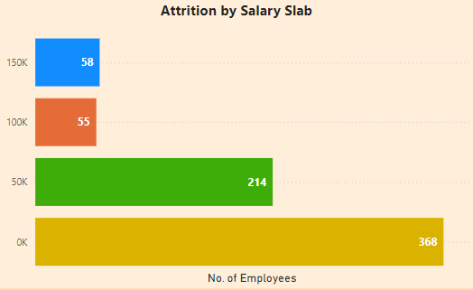
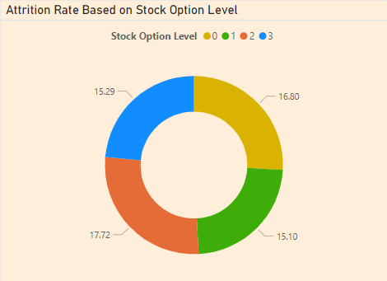
Salary & Financial Incentives
1. Salary
The data indicates that employees with lower monthly incomes are more likely to leave the company. As the monthly income increases, the attrition rate decreases. This trends highlights that, compensation for lower-level employees is Inadequate compared to industry standards. also reiterates the importance of competitive salaries in retaining employees.
2. Stock Options
Employees with stock options at level 2 show a slightly higher attrition rate compared to other levels. This suggests that while stock options are an incentive, they may not be a strong enough factor alone to significantly reduce attrition. Employees might value more immediate or tangible rewards. Companies should consider a mix of financial incentives. While stock options are beneficial, combining them with other forms of compensation may be more effective in retaining employees

Slide 9
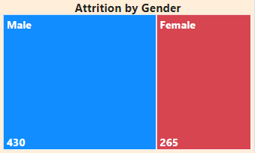


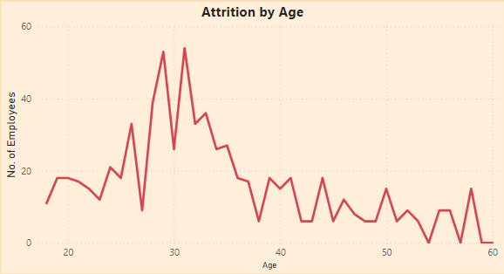
Demographies
1. Gender
The attrition rate among male employees is 16.67%, while among female employees it is 15.31%. Gender appears to have a moderate influence on attrition rates, with slightly higher rates observed among male employees. Possible reasons could include varying job roles, career aspirations, or workplace dynamics influenced by gender-specific factors.
2. Age
Attrition rates vary across different age groups, with notable spikes observed among younger employees (e.g., 28 to 34 years) and fluctuations throughout mid-career stages.
Age-related attrition patterns reflect stages of professional development, career aspirations, and workplace experiences. Younger employees may seek rapid career progression or explore diverse opportunities, leading to higher turnover.

Slide 10
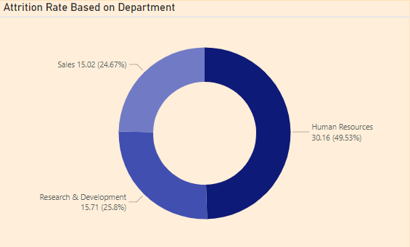
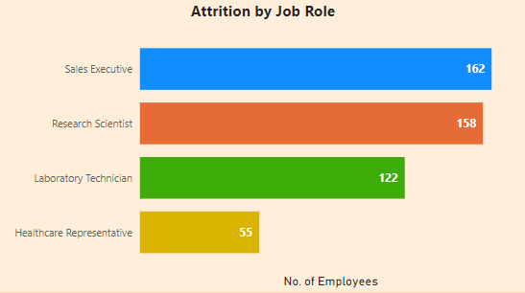
Job Related Factors
1. Department
The high attrition rate in Human Resources suggests possible dissatisfaction within this department, perhaps due to job stress, lack of growth opportunities, or insufficient support. Research & Development and Sales have relatively lower attrition rates but are still significant.
2. Job Role
The highest attrition rates are among Research Directors and Research Scientists, indicating potential issues with job satisfaction or career progression in these roles. Lower attrition rates among Managers and Manufacturing Directors suggest better job stability and satisfaction.

Slide 11
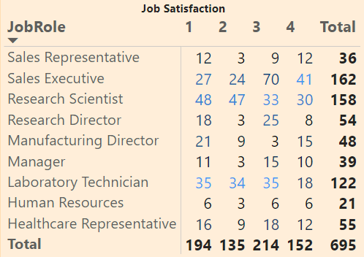
Work Culture
Job Satisfaction based on Job Role
Employees with the lowest satisfaction with their job (rating 1) have the highest attrition rate. As satisfaction increases, attrition decreases significantly, indicating that a positive work environment plays a crucial role in retaining employees. Poor work environment and job satisfaction can lead to high turnover, reducing team cohesion and productivity. Highlighting the importance of ensuring employees find their roles fulfilling and rewarding.

Slide 12
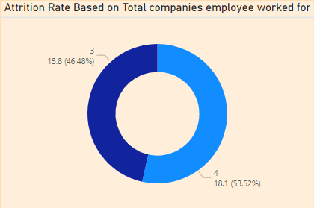
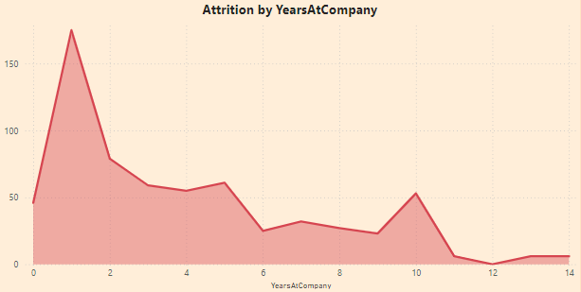
Employee Portfolio
1. Performance Rating
Employees with higher performance ratings (4) have a higher attrition rate compared to those with a lower rating (3). High performers may feel underappreciated or seek better opportunities elsewhere. These employees often drive innovation and efficiency within the company, and their departure can result in decreased performance and morale.
2. Years At Company
Attrition rates are higher at 0 Years (36.36%), 1 Year (34.50%), and again at higher tenure milestones like 23 Years (50%) and 40 Years (100%).
High early attrition suggests issues with integration or satisfaction during the initial employment period. Attrition after longer tenures may be due to retirement or seeking new challenges.

Slide 13
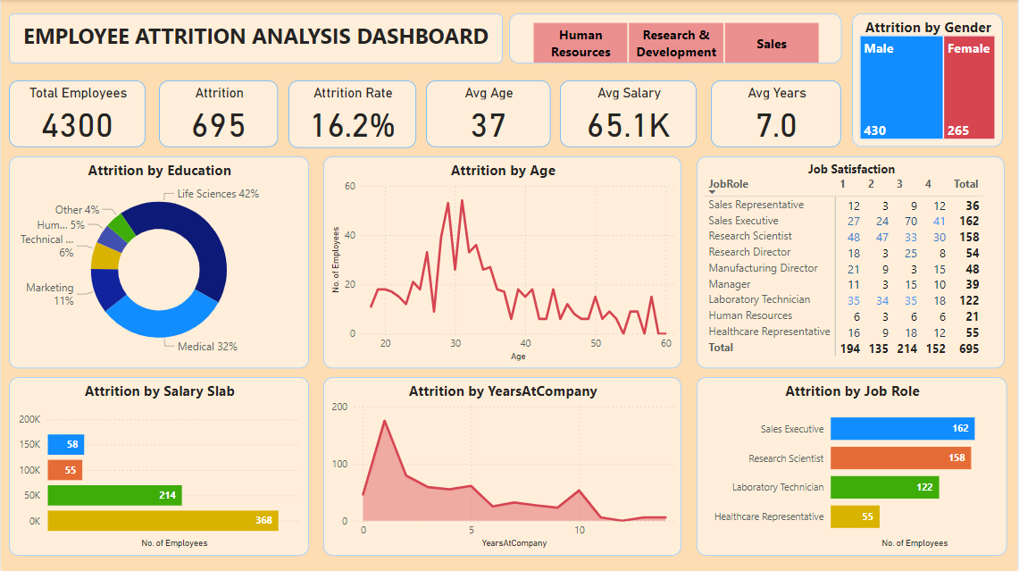

Slide 14
SUMMARY
1.
2.
3.
4.
Demographies
Salary & Financial Incentives
Job Related Factors
Work Culture
Higher attrition among younger employees, single individuals, and males. Younger employees (18-22) and single employees have significantly higher attrition rates.
Moderate correlation between stock options, salary hikes, and attrition. Higher attrition in employees with lower stock options and those receiving minimal salary hikes.
Higher attrition in Human Resources and certain roles like Research Directors. Employees with 0 years under current manager have the highest attrition.
Poor work environment satisfaction, low job satisfaction, and poor work-life balance are linked to higher attrition rates.
7.
6.
5.
Employee Portfolio
Commute & Travel
Career Progression
Higher attrition rates among employees with varied job histories and extensive work experience. New hires and those with many previous employers are more likely to leave.
Greater attrition among employees with long commutes and frequent business travel. Employees with longer commutes (15+ units) and frequent travelers have higher attrition rates.
Higher attrition among employees at lower job levels and those with fewer years since last promotion. Frequent job changes and lack of recent promotions contribute to turnover.

Slide 15
MY RECOMMENDATIONS
01.
Enhance Employee Engagement: Implement programs to improve job satisfaction and work-life balance, especially targeting younger and single employees.
02.
Review Financial Incentives: Offer competitive salary hikes and stock options to retain talent, focusing on those receiving minimal increments.
03.
Support Career Development: Create clear career progression paths and provide regular promotions and training opportunities to boost employee morale.
04.
Improve Work Environment: Foster a positive work culture with a focus on environment satisfaction and job involvement to reduce turnover.
05.
Optimize Commute and Travel Policies: Introduce flexible working arrangements and reduce the need for frequent business travel to lower attrition rates.
06.
Monitor and Support New Hires: Pay special attention to new hires and those with diverse job histories, providing mentorship and integration support to increase retention.

Slide 16

THANK YOU!
FOR YOUR TIME

